Slide 1

Introduction to NLP
Video 6: Methods of Text Preprocessing - Part 3

Slide 2

Preprocessing Techniques
Lowercasing
Removing Punctuation and Special Characters Stop Words Removal
Stemming and Lemmatization Vocabulary Building
Vectorization

Slide 3
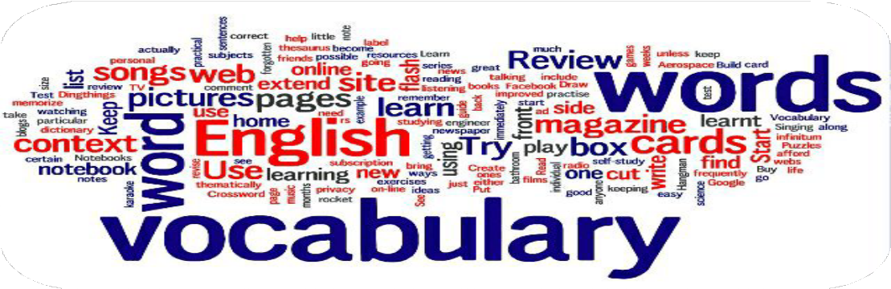
Vocabulary Building
Select and define the set of unique words NLP model will analyse.
Tokens left after preprocessing steps : Base for the model

Slide 4
Jupyter Notebook

Slide 5

Vectorization

Slide 6
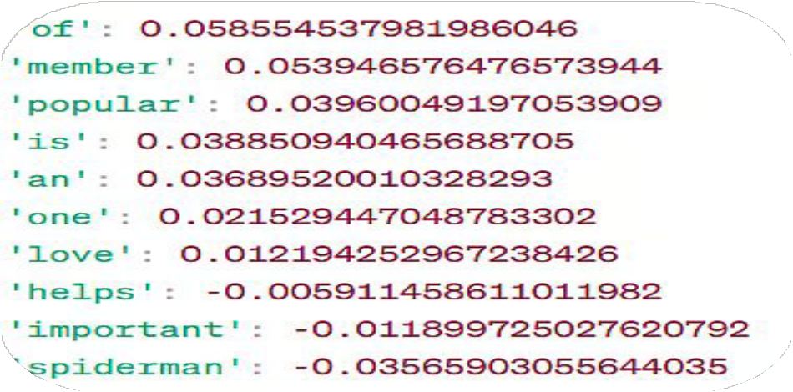
Vectorization
Convert words into numerical representations called vectors.

Slide 7

Vectorization
One Hot Encoding
Count Vectorizer
TF-IDF
Word Embedding

Slide 8
Vectorization
One Hot Encoding
Count Vectorizer
TF-IDF
Word Embedding

Slide 9
Vectorization
One Hot Encoding
Count Vectorizer
TF-IDF
Word Embedding

Slide 10
One-Hot Encoding
Binary vector to show whether a word appears in a document.
1
Word is present
0
Word is absent

Slide 11
One Hot Encoding
Vocabulary
Documents
Document | life | beautiful | surprising | struggle | teaches | resilience | growth
Document 1 | 1 | 1 | 0 | 0 | 0 | 0 | 0
Document 2 | 1 | 0 | 1 | 0 | 0 | 0 | 0
Document 3 | 1 | 0 | 0 | 1 | 1 | 1 | 1

Slide 12
One Hot Encoding
Document 1 : “Life is beautiful.” Document 2 : “ Life is surprising.”
Document 3 : “Struggle in life teaches resilience and growth.”

Slide 13
One Hot Encoding
Document 1 : “Life is beautiful.” Document 2 : “ Life is surprising.”
Document 3 : “Struggle in life teaches resilience and growth.”
life
beautiful

Slide 14
One Hot Encoding
Document 1 : “Life is beautiful.” Document 2 : “ Life is surprising.”
Document 3 : “Struggle in life teaches resilience and growth.”
life
beautiful
surprising

Slide 15
One Hot Encoding
Document 1 : “Life is beautiful.” Document 2 : “ Life is surprising.”
Document 3 : “Struggle in life teaches resilience and growth.”
life
beautiful
surprising
struggle
teaches
resilience
growth

Slide 16
One Hot Encoding
Document | life | beautiful | surprising | struggle | teaches | resilience | growth
Document 1 | 1 | 1 | 0 | 0 | 0 | 0 | 0
Document 2 | 1 | 0 | 1 | 0 | 0 | 0 | 0
Document 3 | 1 | 0 | 0 | 1 | 1 | 1 | 1
life
beautiful
surprising
struggle
teaches
resilience
growth

Slide 17
Jupyter Notebook

Slide 18
Vectorization
One Hot Encoding
Count Vectorization
TF-IDF
Word Embedding

Slide 19
Count Vectorization
Represented as matrix of token counts.
Document | life | beautiful | surprising | struggle | turn | teaches | resilience | growth
Document 1 | 3 | 2 | 0 | 0 | 1 | 0 | 0 | 0
Document 2 | 2 | 0 | 1 | 0 | 0 | 0 | 0 | 0
Document 3 | 3 | 0 | 0 | 1 | 1 | 1 | 1 | 1

Slide 20
Count Vectorization
Document 1 : “Life is life, life is beautiful and full of beautiful turns.” Document 2 : “ Life surprises us at every turn of life”
Document 3 : “Struggle in life teaches resilience, life, and growth in life.”

Slide 21
Count Vectorization
Document 1 : “Life is life, life is beautiful and full beautiful turns.” Document 2 : “ Life surprises us at every turn of life”
Document 3 : “Struggle in life teaches resilience, life, and growth in life.”
life
beautiful
surprises
struggle
turn
teaches
resilience
growth

Slide 22
Count Vectorization
Document | life | beautiful | surprising | struggle | turn | teaches | resilience | growth
Document 1 | 3 | 2 | 0 | 0 | 1 | 0 | 0 | 0
Document 2 | 2 | 0 | 1 | 0 | 0 | 0 | 0 | 0
Document 3 | 3 | 0 | 0 | 1 | 1 | 1 | 1 | 1
life
beautiful
surprises
struggle
turn
teaches
resilience
growth

Slide 23
Jupyter Notebook

